Slide 1
Screen Time
By Lorenzo Gordon

Slide 2
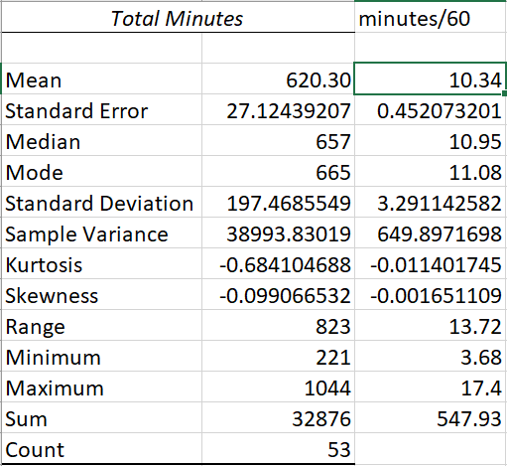
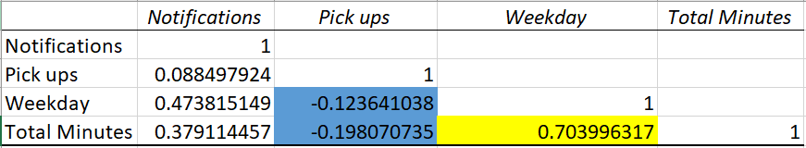
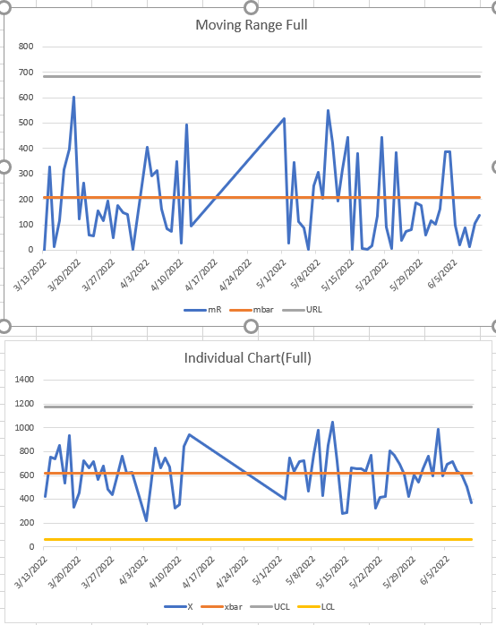
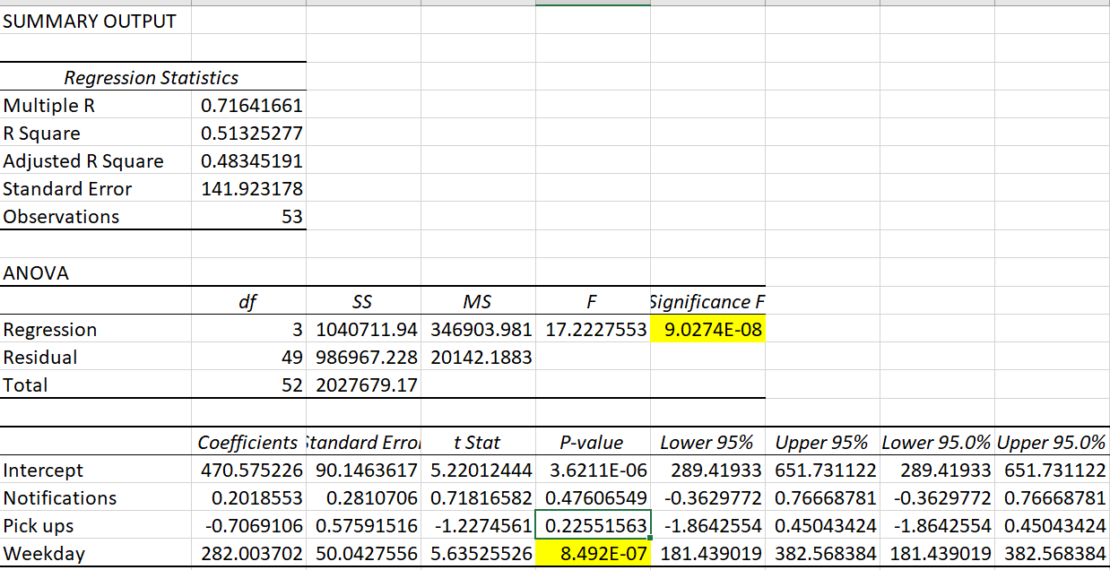
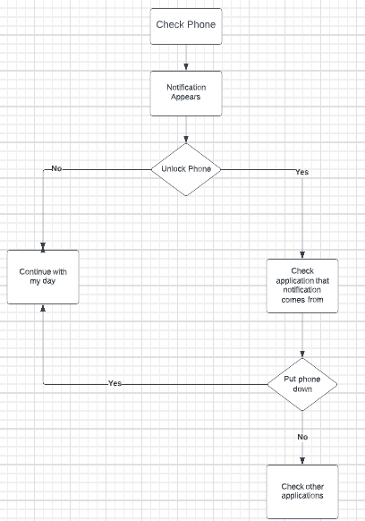


Define: 4/14/22 | Measurement: 4/25/22 | Analyze: 5/20/22 | Improvement: 5/25/22 | Control: 6/10->
Define
The problem that I will be looking to resolve is reducing my screen time on iPhone. I’m constantly checking my phone has caused me to not be present in the moment when around friends/family. I normally average anywhere to 10-11 hours of screentime. I would like to reduce this to less than 10 hours which can be achieved by using my less than my average screen hours.
Process Map:
SQL(From Table): 1.3
The sigma quality level for my current process is not great and there is room for improvement.
Measure
The mean for the total # of minutes that I have for screen time came out to 620.30. After dividing that by 60(Number of minutes in hour) comes out to 10.33 hours which is equivalent to 10 hours and 19 minutes of screentime. (WOW)
Some other interesting numbers discovered were:
Analyze
Correlation:
Total minutes and the binary weekday variable (yes/no) have the strongest positive correlation of the data. Also increasing to see the pickups has a negative correlation with both minutes and weekday
Multiple Regression
Only significant value is Weekday when it comes to the total minutes of screentime. Focus on weekday phone activity. The negative correlation between pickups and screentime to be explored too.
Chi Square:
Ho= Weekday and Minutes are independent
Ha= Weekday and minutes are not independent
Pvalue: 1.50425E-06
This indicate that there may be some relationship between the two.
Improvement
Focus on weekdays and put some focus on pickup amount.
Our control chart seems to be much lower after introducing the improvements on the weekdays around the 5/22 marker. However, my total average gone up 14 minutes to 10hours and 33 minutes
Control:
New SQL: 1.6

Slide 3
Define
The problem that I will be looking to resolve is reducing my screen time on iPhone. I normally average anywhere to 10-11 hours of screentime. I would like to reduce this to less than 10 hours which can be achieved by using my less than my average screen hours.
This problem should be fixed because it impacts the amount of time that I’m being productive. It interferes with studying, work, and family time. The benefit of reducing my screen is it will increase the time I spend being productive, by focusing on things that beneficial. If I quantify this problem, I will base it on a combination of my salary based on hours and daily cost of my gym membership, so $45 an hour.
This will be considered a success if I bring my average time below 10 hours and 20 minutes. By reducing the hours, I will be able to apply that time to more productive actives such as physical activity, studying, and other non phone related leisure activities

Slide 4
Operational Definition
Minutes: The total amount of minutes I’ve spent on the phone
Pickups: number of times I pick up my phone a day
Screen Time(hour): How many hour I’ve spent actively on the phone. (not including minutes)
Screen Time(minute): How many minutes, in addition to hours, i’ve spent on the phone
Notifications: How many notifications am I receiving from different applications on my phone
Weekday: If the date is a weekday(M-F) or weekend
a potential errors that could occur are apple deleting screentime dates if not recorded in time

Slide 5
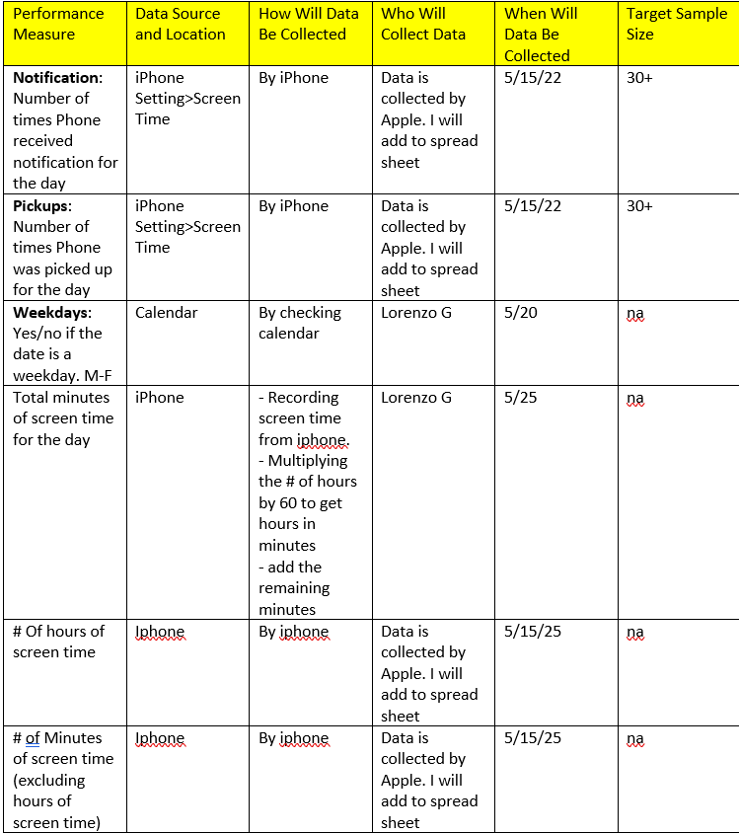
Data Measurement Plan

Slide 6
Define: Process Map

Slide 7
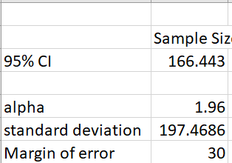
Sample Size
I chose a 30-minute margin of error for my sample size so that even if I can’t reduce by an hour, we can hopefully see some changes within the margin of error range. My formula resulted in 166 samples needed to ideally track and analyze these changes. For analyze stage I was only able to gather 53 points

Slide 8
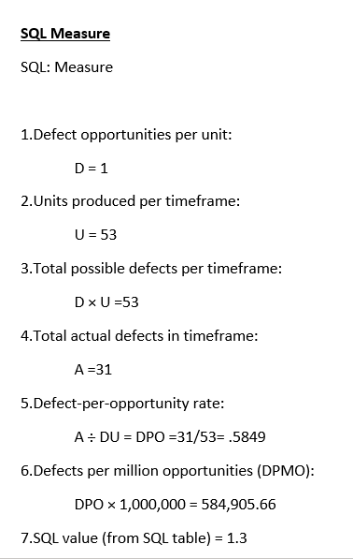
Analyze: Sigma Quality Level

Slide 9
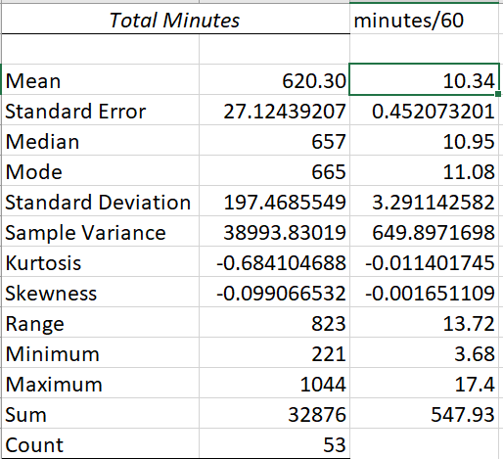
Descriptive Stats
As I called out earlier, we can see that my mean total minutes from the 53 data points ends somewhere around 620.30 minutes. Which when you divide by 60 to get it into hours is around 10 hours and 19 minutes. The most frequent value that appears is over 11 hours(!) of screen time a day. Both the median and mode of my data appear to be higher than the calculated average. My highest amount of screentime was 17 hours

Slide 10

Correlation
I wanted to investigate the relationship between the variables for my data to see if anything stood out immediately. The two points that I found interesting were:
Pickups seems to have a slight negative relationship with both my Weekday variable and Total minutes. Meaning that the greater number of pickups I have the smaller number of hours I spend on my phone and When it is a weekday, I have less pickups. My interpretation of this Is that if I'm picking up my phone more often that could mean that I was not looking at it begin with or spending more time.
The strong relationship between weekday and total minutes coming in at .70

Slide 11
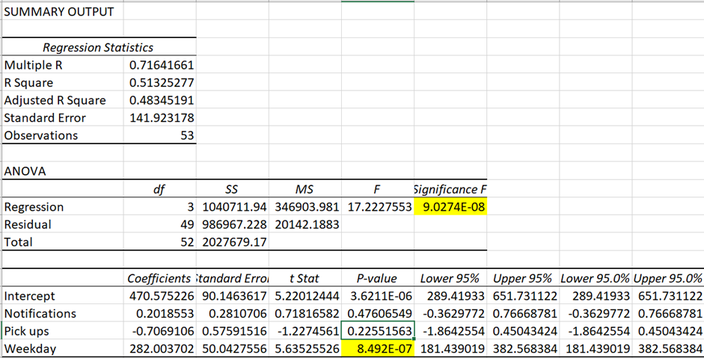
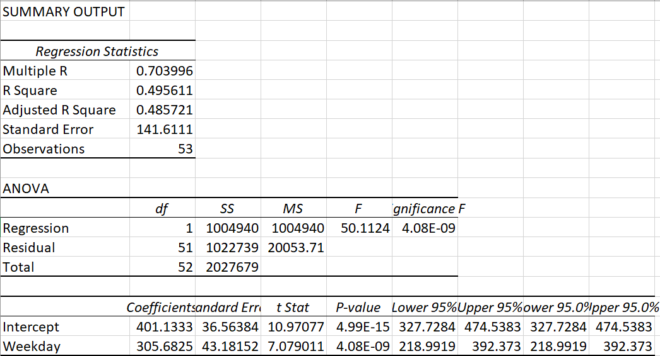
Multi + Linear Regression
Moving into regression I wanted to explore further into the relationship between my variables. With the multi-regression we can that this accounted for 50% of the change in my minutes and the formula is statistically significant as pointed out in F. However, the only variable that is significant is weekday which came in well below the alpha level of 0.05. So, I decided to look at liner regression between weekday and minutes. It seems like the weekday was providing most of the changes that we saw in the multi regression. Based on the linear regression results my screentime could increases by around 305 min just because it is a weekday.

Slide 12
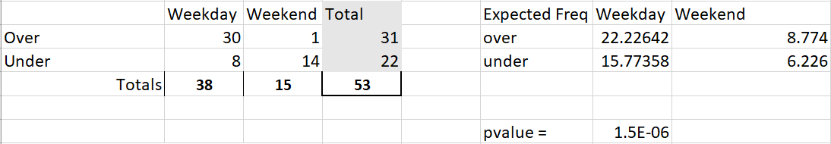
Chi Square Test
In hopes of confirming what we saw in the previous slide I complete a chisquare test of weekday and minutes over the average.
Ho: Minutes and Weekday have no Relationship
Ha: There is a relationship between minutes ad weekday
Based on the pvalue from my expected table it confirms that weekdays and my minutes have a relationship.
Moving forward I wanted to keep my weekday screentime in mind to help reduce my overall screentime. I also believed that pickups may be a good indicator that I’m reducing my active screentime as it was my only negative correlation.

Slide 13
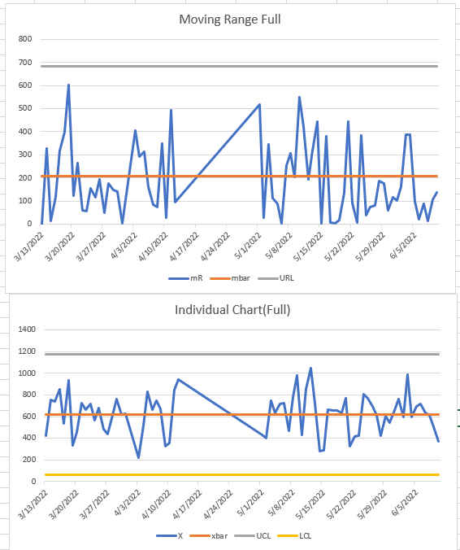
Improve
I used a moving range chart to help view my improvement phase. I’m using continuous data that capture one point which is my total minutes. From my moving range it shows that in general my minutes seem to stay below the mbar line, but I just have big spikes in the increase of my minutes earlier on. Towards the end of the moving range when I started focusing on reducing my screentime on weekdays to help my overall average it seems more of the chart if falling below the mbar line and is starting to trend lower.
Improvement phase

Slide 14
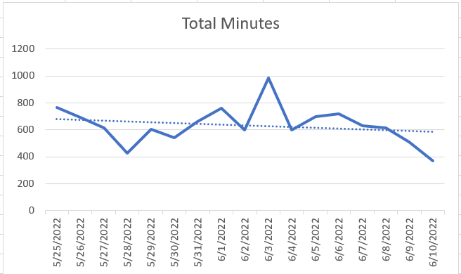
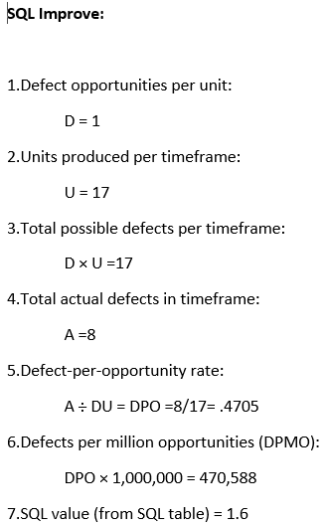
Control
SQL: 1.3 → 1.6
The new sql that I calculated after putting focus on my screentime on weekday is 1.6 which is a slight increase in my sql score in comparison to where we started. My weekday screentime is starting to trend lower as we see in the chart, however my average minutes during the improvement period has gone up by 14 minutes to 10 hours and 33 minutes. My assumption is that my weekend screentime may be increasing. A larger sample size would help confirm or deny that belief

Slide 15
Conclusion
Focusing on weekday screentime may lead to an overall reduction in my screentime. Though I was only able to gather 17 samples for my improvement phase I do believe continuing to make changes in that area will bring me to my goal.
Some datapoints that I would like to collect to further analyze this would be the breakdown of my screentime uses by app category.
Apple provides a feature where it measures your screentime by application category such as
Social media
Productivity
Others
I think looking into this area can give some further insight into what is driving my screentime. Could it be work related application being used primarily or Social media/entertainment applications

